Slide 1
Expanding Access:
Free Student Learning Tools and Assistive Technology
Matt Farley and Sonya Woods
February, 2026

Slide 2
Accessibility Best Practices
Assistive Technology doesn’t fix accessibility issues, it expands access and works better when content has:
Correctly marked up headings, lists, and tables
High-quality images with text descriptions
Links with descriptive link text
Good color contrast
Videos with accurate captions and transcripts

Slide 3
Accessibility and Assistive Technology Trends
Proliferation of low-cost or free tools, browser extensions, etc.
Accessibility features now standard in many tools and devices
Emphasis on proactive accessibility to ensure digital content can be morphed or converted to match user preference

Slide 4
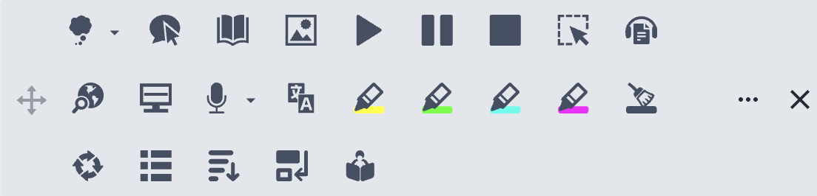
Read & Write

Slide 5
Read & Write – Key Features
Text-to-speech: Web pages, PDFs, Word
Text & Picture Dictionaries
Vocabulary List
Rewordify: simplifies readability without changing meaning
Check It: Reviews writing for incorrect grammar, spelling, capitalization, punctuation, verb tense and more.
Audio Maker
Talk & Type

Slide 6
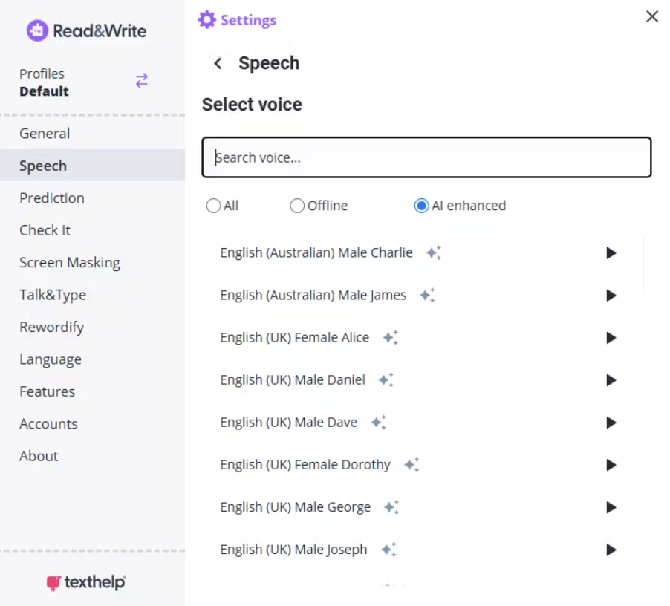
Read & Write AI-Enhanced Voices

Slide 7
Read & Write – Availability
University-licensed tool available for free to all faculty, staff, and students
Mac and Windows apps available
Web extension for Chrome

Slide 8
Immersive Reader & Office 365

Slide 9
Immersive Reader
Built-in to Canvas pages
Available in Word and Outlook
Enhances readability by focusing on main content
Provides the option to read text aloud
Includes various reading and study tools

Slide 10
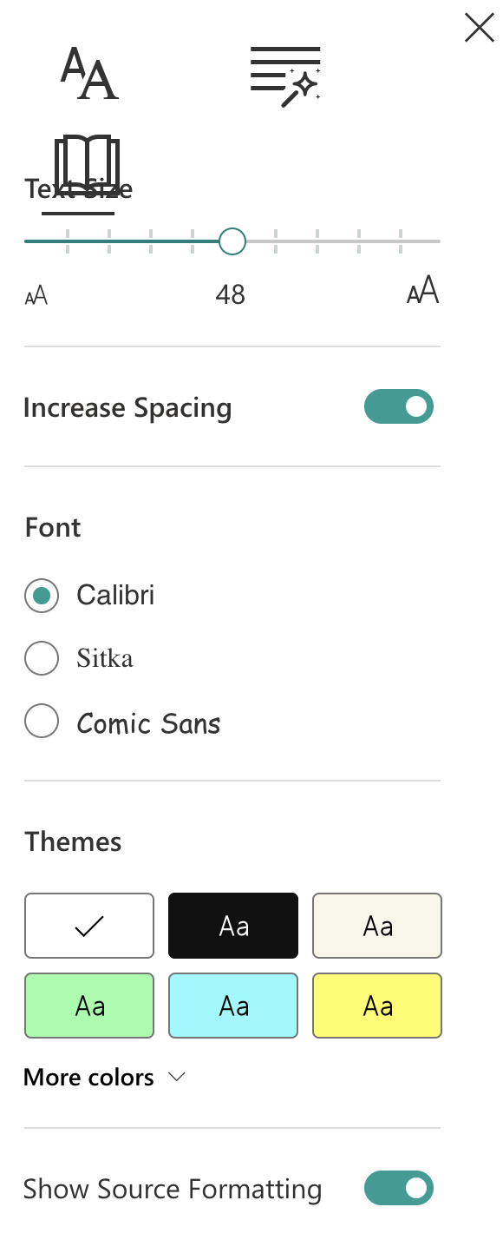
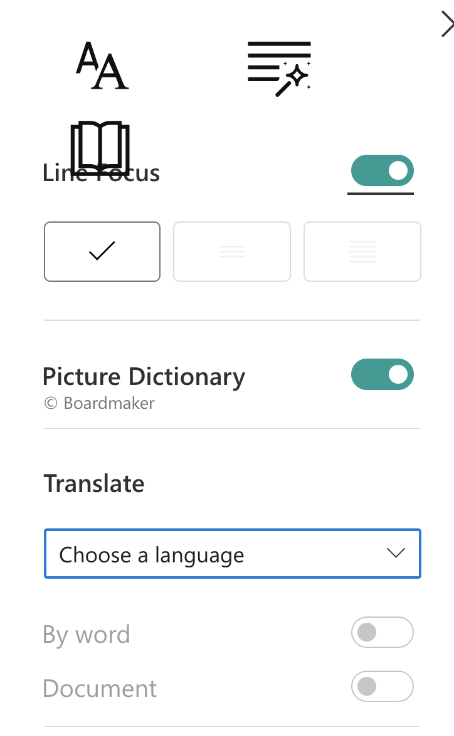
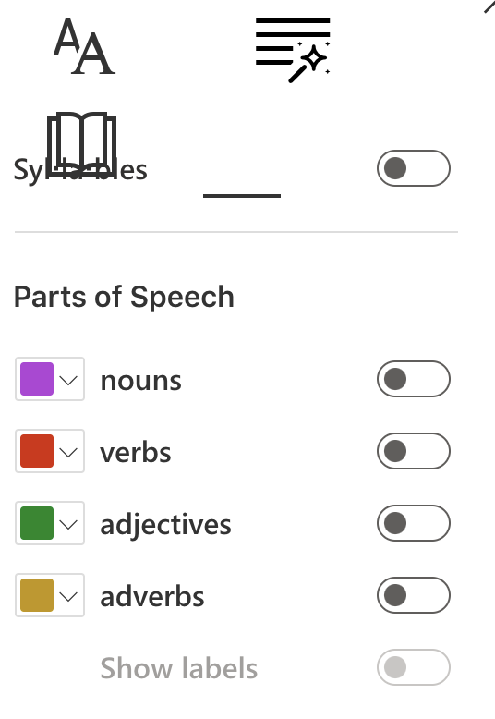

Slide 11
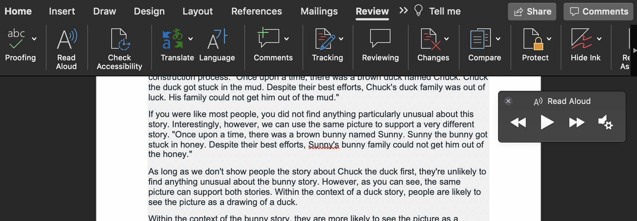
Read Aloud in Word

Slide 12
Other Office 365 Features
Full keyboard support
Compatible with screen readers
Dictate
Check Accessibility tool

Slide 13
Ally

Slide 14
What is Ally?
Accessibility tool integrated into Canvas that has two components:
Reviews and scores content to highlight accessibility issues
Format conversion tool for documents and Canvas pages

Slide 15
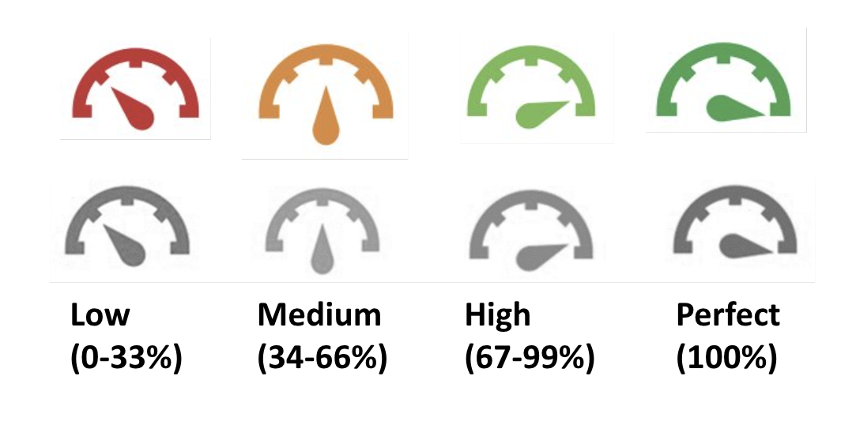
Ally Score Indicators

Slide 16
Ally Score Factors
Ally Checks
Canvas LMS items
Uploaded files (PDF, Images, Word, PPT, HTML)
Ally Does Not Check
Externally linked content
Iframed or embedded content
Exception: YouTube videos

Slide 17
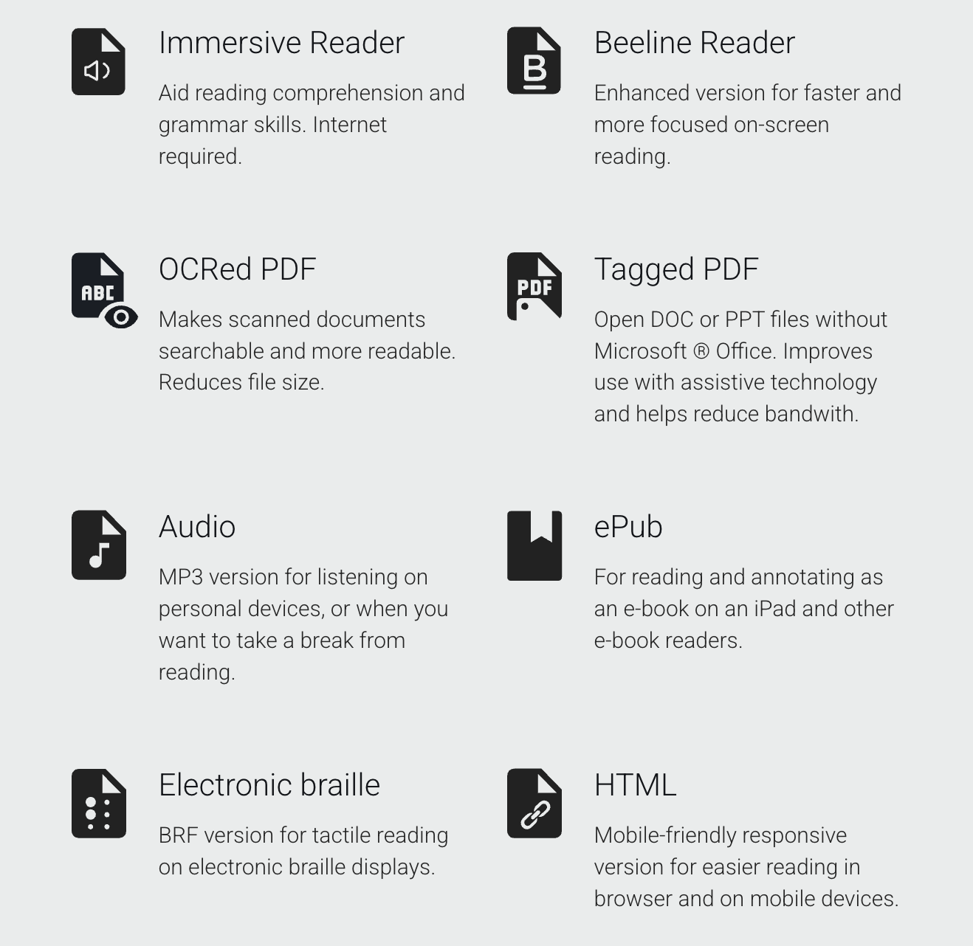
Ally Alternative Formats

Slide 18
Sensus Access

Slide 19
Sensus Access
Document remediation and conversion service
Convert documents into audio books (MP3 and DAISY), e-books (EPUB, EPUB3 and Mobi), digital Braille, digital large-print, and BeeLine Reader.
Remediate inaccessible documents such as image-only PDF files, JPG pictures, Microsoft PowerPoint presentations, and LaTeX
Translate documents

Slide 20
EquatIO

Slide 21
EquatIO Toolbar Features
Equation Editor
LaTeX Editor
Graph Editor
Handwriting Recognition
Speech Input
EquatIO Mobile
Screenshot Reader

Slide 22
Built-In Device Features

Slide 23
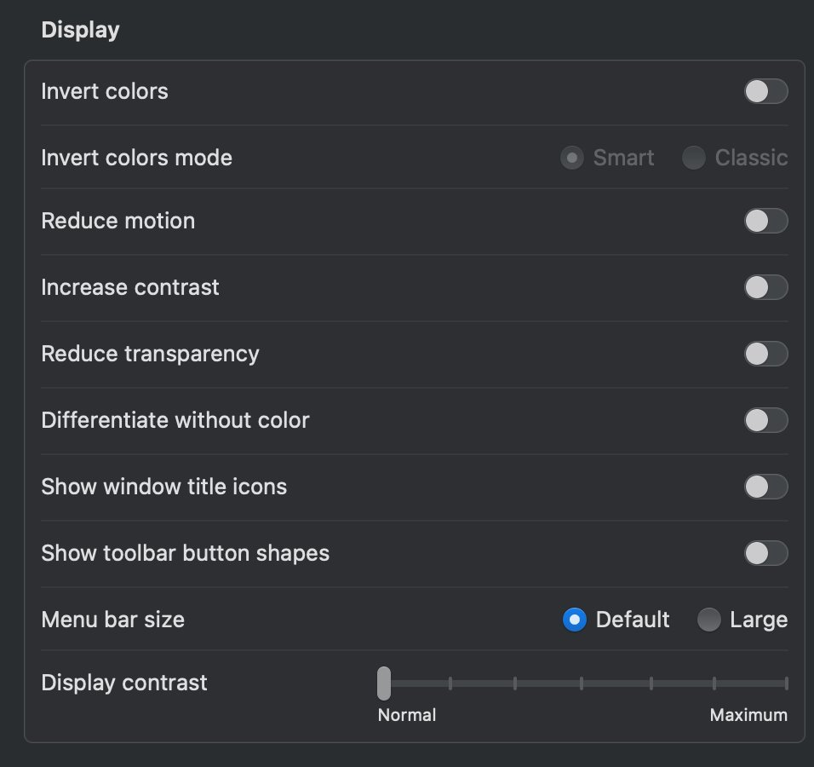
Mac - Display Settings

Slide 24
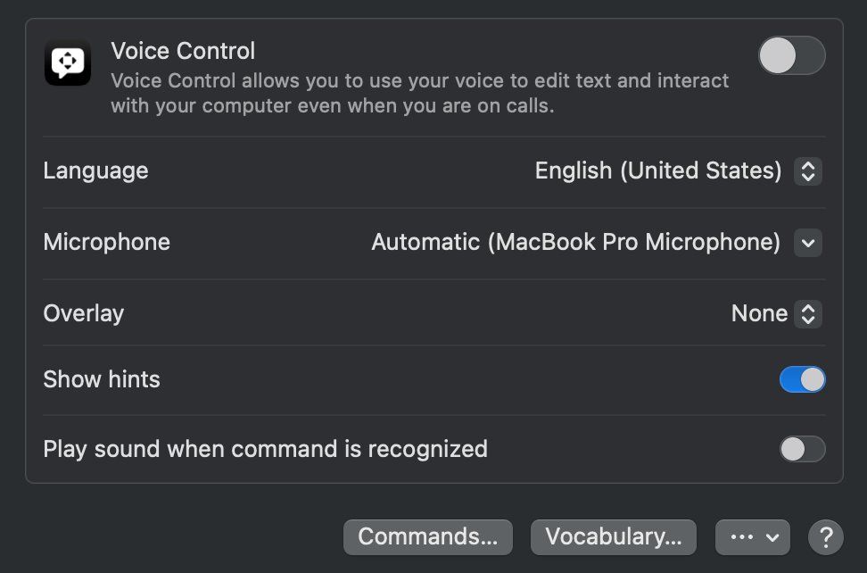
Mac - Voice Control

Slide 25
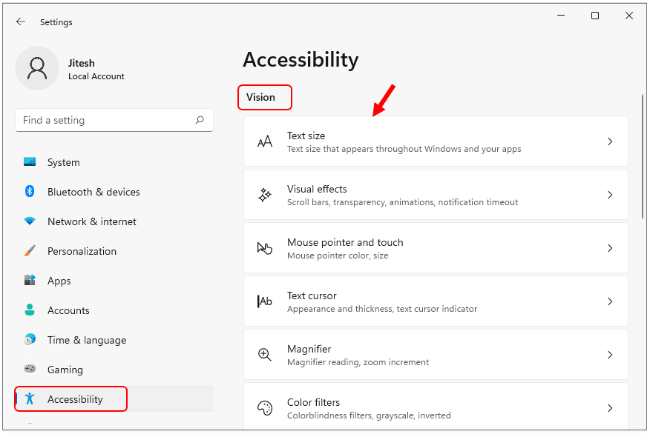
Windows

Slide 26
Other Free Tool Recommendations

Slide 27
Other Free Tool Recommendations
Thorium Reader
Postlight Reader
Morphic

Slide 28
Resources
Office 365 Accessibility Tools (https://support.microsoft.com/en-us/office/accessibility-tools-for-microsoft-365-b5087b20-1387-4686-a0a5-8e11c5f46cdf)
Read & Write (https://equity.psu.edu/offices/student-disability-resources/accommodations/read-write)
Ally Resources (https://accessibility.psu.edu/software/canvas/anthologyally/)
Sensus Access (https://accessibility.psu.edu/sensus/)
EquatIO (https://equity.psu.edu/offices/student-disability-resources/accommodations/equatio)
World Campus Accessibility Team (https://pennstateoffice365.sharepoint.com/sites/WorldCampusAccessibilityTeam)
mtf157@psu.edu
szw151@psu.edu

